Slide 1
بسم اللہ الرّحمٰن الرّحیم

Slide 2

EE213 Computer organization and assembly language
Spring 2018

Slide 3
x86 Instruction Encoding (12.3)

Slide 4
Outlines
Introduction
Instruction Format
Single Byte Instructions
Move Immediate to Register
Register Mode Instructions
Processor Operand-Size Prefix
Memory Mode Instructions
Notes:
The details you learn in this chapter are how arguments are passed by value and by reference, how local variables are created and destroyed, and how recursion is implemented.

Slide 5
Introduction
The Intel 8086 processor was the first in a line of processors using a Complex Instruction Set Computer (CISC) design.
a wide variety of memory-addressing, shifting, arithmetic, data movement, and logical operations.
To encode an instruction means to convert an assembly language instruction and its operands into machine code.
To decode an instruction means to convert a machine code instruction into assembly language.
We will begin with the 8086/8088 processor as an illustrative example.
Later, we will show some of the changes made when Intel introduced 32-bit processors.

Slide 6
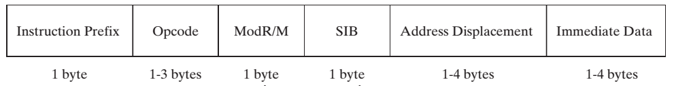
Instruction Format
Instructions are stored in little-endian order, so the prefix byte is located at the instruction’s starting address.
Every instruction has an opcode, but the remaining fields are optional.
Most instructions are 2 or 3 bytes.

Slide 7
The instruction prefix overrides default operand sizes. The prefix byte is not the opcode expansion prefix discussed earlier - they are special bytes to modify the behavior of existing instruction
The opcode (operation code) identifies a specific variant of an instruction.
E.g. the ADD instruction has nine different opcodes, depending on the parameter types used.
The Mod R/M field identifies the addressing mode and operands. The notation “R/M” stands for register and mode.
The scale index byte (SIB) is used to calculate offsets of array indexes.
The address displacement field holds an operand’s offset, or it can be added to base and index registers in addressing modes such as base-displacement or base-index-displacement
The immediate data field holds constant operands
Notes:
Addressing modes: Register, Register Indirect, Immediate Addressing, Base/Base-Offest/Displacement Addressing, PC-relative addressing: the value in the immediate field is interpreted as an offset of the next instruction (PC+4 of current instruction).

Slide 8
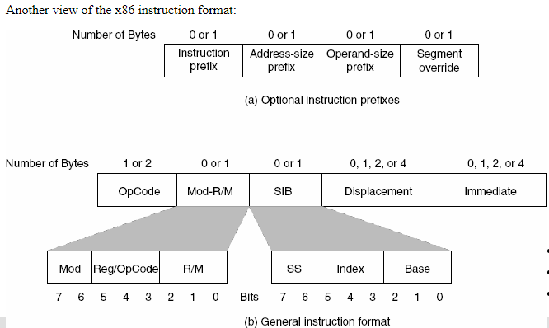

Slide 9
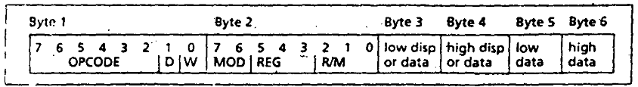
The six-bit opcode identifies the operation. The same opcode is used for both 8- and 16-bit operations.
The size of the operands is given by the W bit: W = 0 means 8-bit data and W = 1 means 16-bit (or 32 bits) data.
Bit number one, marked D, specifies the direction of the data transfer:
If d = 0 then the destination operand is a memory location, e.g.
e.g. add [ebx], al
If d = 1 then the destination operand is a register, e.g.
e.g. add al, [ebx]
the D bit specifies whether the register in the REG field is a source or destination operand, D = 0 means source and D = 1 means destination.

Slide 10

The MODR/M byte (byte 2 above) specifies instruction operands and their addressing mode
The R/M field, combined with MOD, specifies either
the second operand in a two-operand instruction, or
the only operand in a single-operand instruction like NOT or NEG.
These two are used to let the CPU know if there is some memory opeand, if yes, then how to calculate its offset address.

Slide 11
The MOD field specifies x86 addressing mode
MOD = 11 means register mode.
MOD = 00 means memory mode with no displacement.
(Except when R/M= 110, then a 16-bit displacement follows).
MOD= 01 means memory, with 8 bit displacement following (D8).
MOD = 10 means memory mode with 16-bit displacement following (D16).

Slide 12
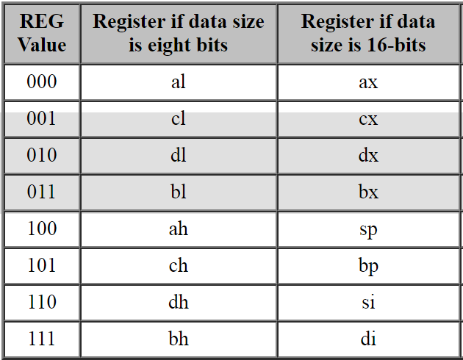
The REG field specifies source or destination register.
For certain (often single-operand or immediate-operand) instructions, the REG field may contain an opcode extension rather than the register bits.
The R/M field will specify the operand in such case.
Depending on the instruction, this can be either the source or the destination operand
(W = 0)
(W =1)

Slide 13
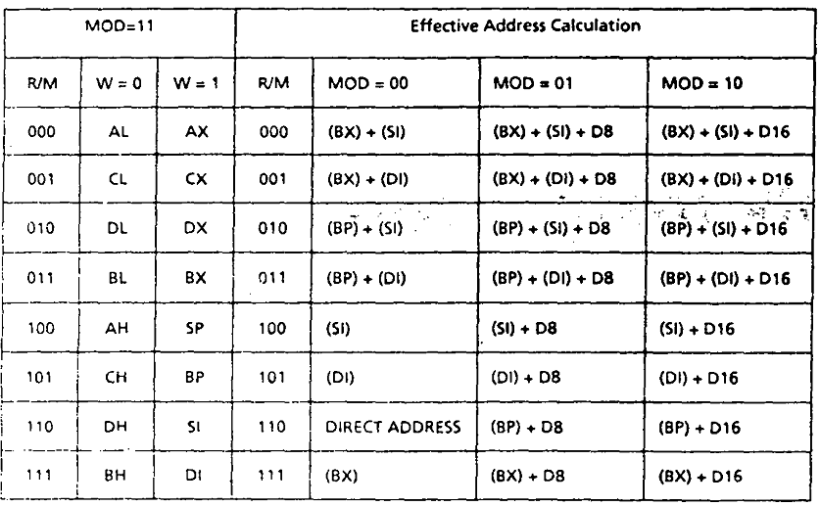
MOD and R/M Fields

Slide 14
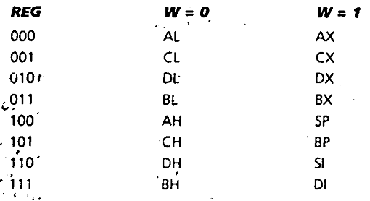
Register Encoding

Slide 15
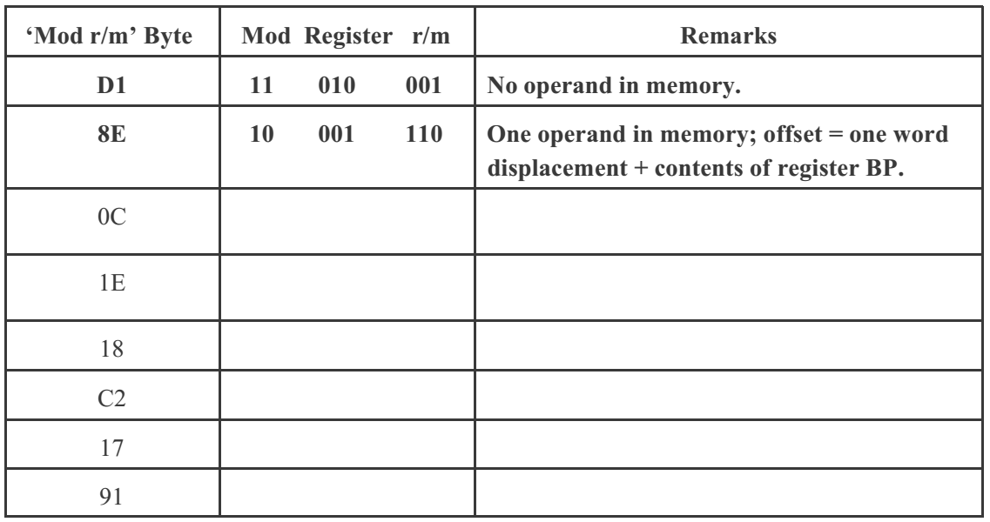

Slide 16
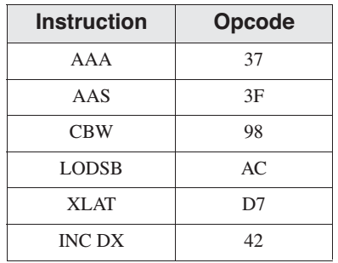
Single-Byte Instructions
The simplest type of instruction is one with either no operand or an implied operand. Such instructions require only the opcode field, the value of which is predetermined by the processor’s instruction set.
register increments are optimized for code size and execution speed

Slide 17
Single Immediate Data
When the only operand of an instruction is an immediate data the machine language code is the opcode followed by that immediate data.
E.g. RET 8 is C2 08 00, where C2 is the opcode and 0008 is the immediate data (appended in little endian order).

Slide 18
Move Immediate to Register
Immediate operands (constants) are appended to instructions in little-endian order (lowest byte first).
The encoding format of a MOV instruction that moves an immediate word into a register is
B8 + rw dw
where the opcode byte value is B8 + rw, indicating that a register number (0 through 7) is added to B8
dw is the immediate word operand, low byte first.

Slide 19
Example: MOV AX,1 The machine instruction is B8 01 00 (hexadecimal). Here’s how it is encoded:
The opcode for moving an immediate value to a 16-bit register is B8.
The register number for AX is 0, so 0 is added to B8
The immediate operand (0001) is appended to the instruction in little-endian order (01 , 00)

Slide 20
Example: MOV BX, 1234h The machine instruction is BB 34 12. The encoding steps are as follows:
The opcode for moving an immediate value to a 16-bit register is B8.
The register number for BX is 3, so add 3 to B8, producing opcode BB.
The immediate operand bytes are 34 12.

Slide 21
Single Operand (in a register) Instructions
The machine language instruction can be obtained by adding to the register number to the opcode byte.
Example: PUSH CX The machine instruction is 51. The encoding steps are as follows:
The opcode for PUSH with a 16-bit register operand is 50.
The register number for CX is 1, so add 1 to 50, producing opcode 51.

Slide 22
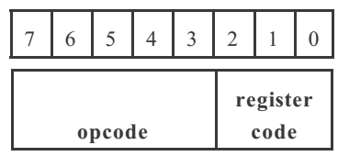

Slide 23
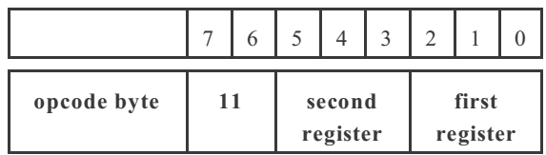
Register-Mode Instructions
In instructions using register operands, the Mod R/M byte contains a 3-bit identifier for each register operand.
Bits 6 to 7 are the mod field, which identifies the addressing mode.
Bits 3 to 5 are the reg field, which identifies the source operand.
Bits 0 to 2 are the r/m field, which identifies the destination operand.

Slide 24
e.g.
ADD CX, AX
= 00000001 11 000 001
= 01C1 h

Slide 25
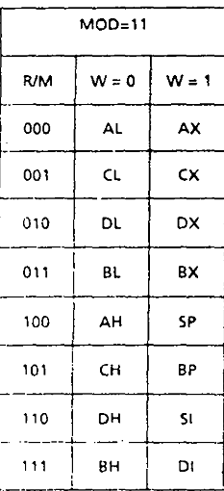

Slide 26
Memory Mode Instructions
The two bits in the Mod column indicate groups of addressing modes.
Mod 00, for example, has eight possible R/M values (000 to 111 binary) that identify operand types listed in the Effective Address column.
Encode :
MOV AX, [SI] ;
MOV [SI], AL

Slide 27
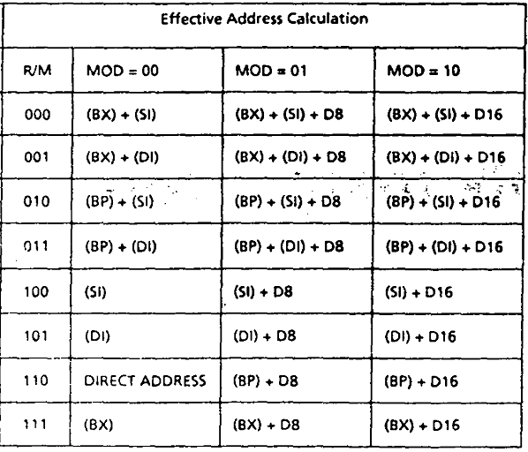

Slide 28
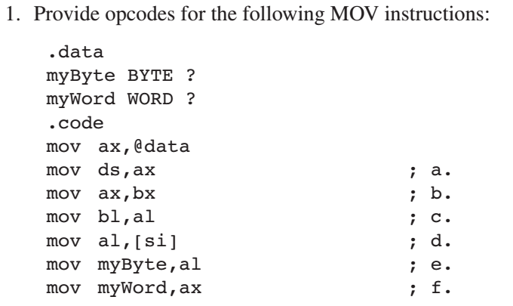

Slide 29
